Slide 1
Smart Buy
Buy everything you need in a smart way

Slide 2
Team member
Supervisor: Mr. Kiều Trọng Khánh
Đoàn Hồ Anh Triết
Đặng Hữu Hoàng
Trần Trung Dũng
Huỳnh Thanh Việt (Dropped out)

Slide 3
Outline
Scenario problem
Our solution
Demonstration
Advantages and disadvantages of current solution
Questions and answers

Slide 4
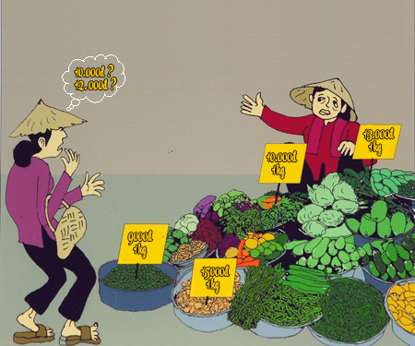
Scenario Problem

Slide 5
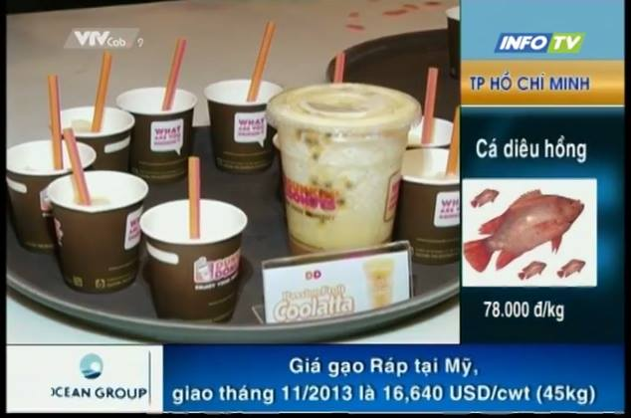
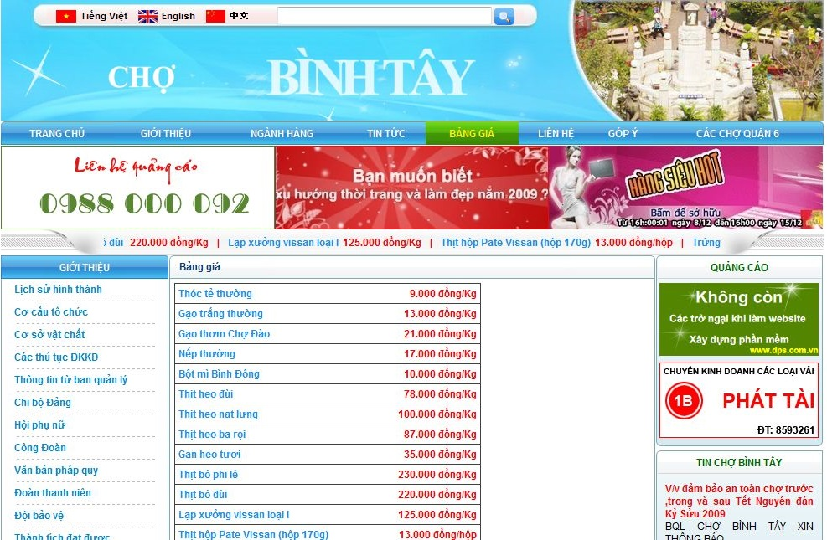
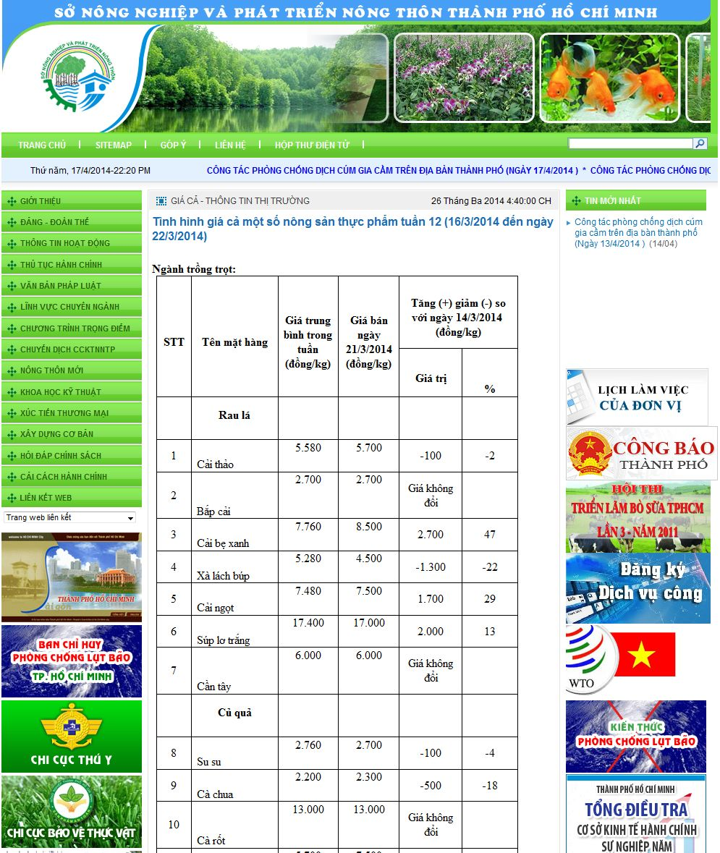
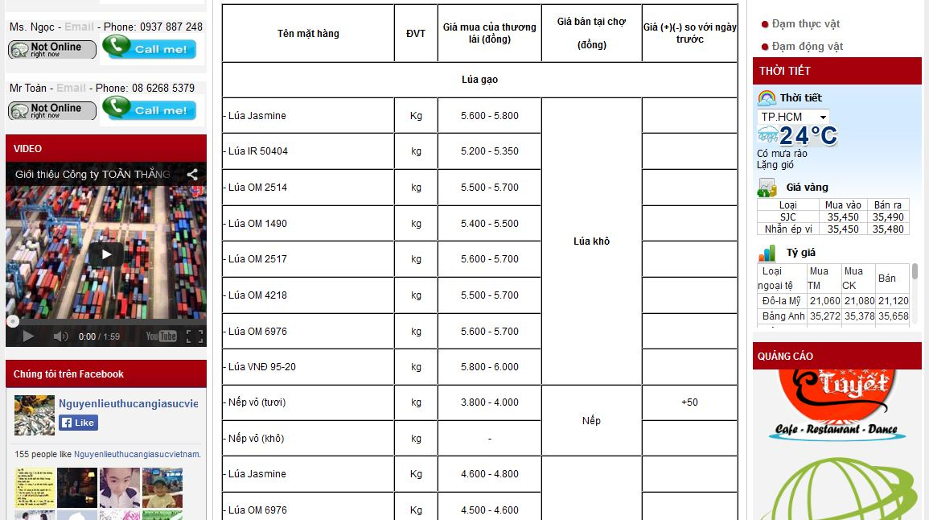
Scenario Problem

Slide 6
Our Ideas
Collect data
Build structure
Public to end user

Slide 7

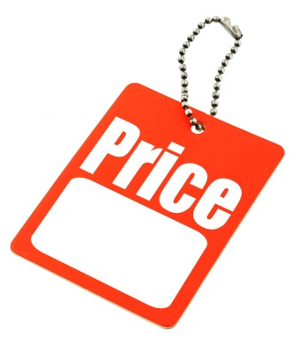

Our Solution
Track
Give
System
Price
Suggestion

Slide 8




Demonstration Story

Slide 9
Story Board
1 guest.
1 member.
1 staff.

Slide 10




Demo Scenario - Guest
Search product
Add to cart.
View cart
View list

Slide 11


Demo Scenario - Member
Define Routes
Ask for suggestion

Slide 12
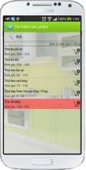


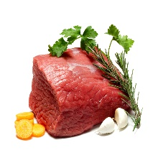








Mobile Member
1.1
Guest
1.2
1.3
2.3
2.6
2.4
2.2
2.5
2.1
Member

Slide 13

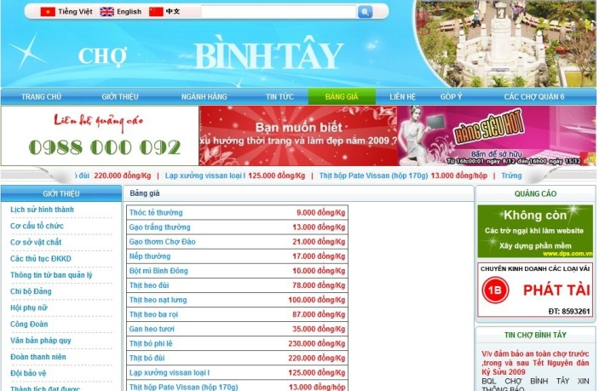


Data Source

Slide 14


Demo Scenario - Staff
Import data
Train machine
Manage parsers

Slide 15
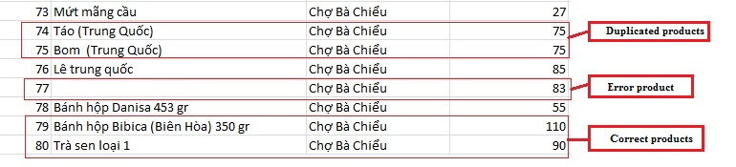
Terminology
Duplicate
Error
Correct
Merge (gộp): make two or more names refer to one product.
Split (tách): different names mean different products.

Slide 16
Import Excel Flow
EXCEL FILE
1
2
3
Correct Products List
Error Products List
Duplicate Products List

Slide 17
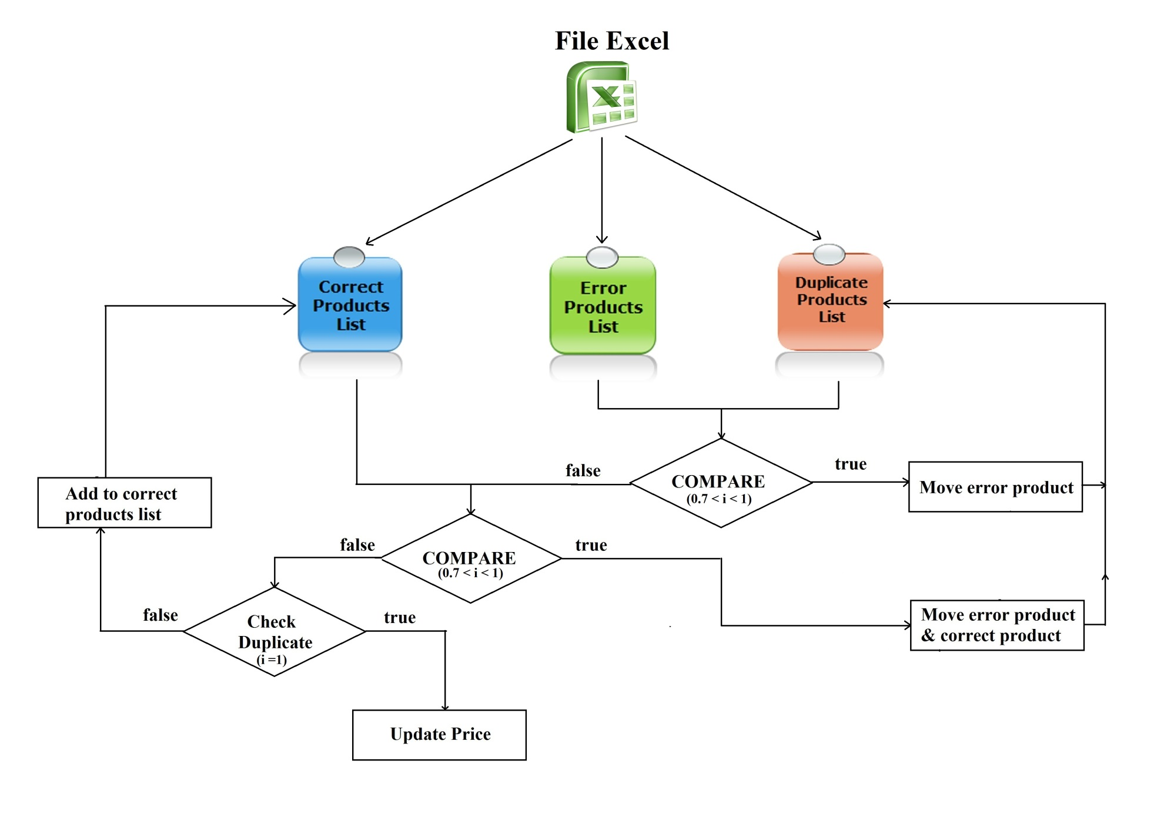
Import Excel Flow

Slide 18
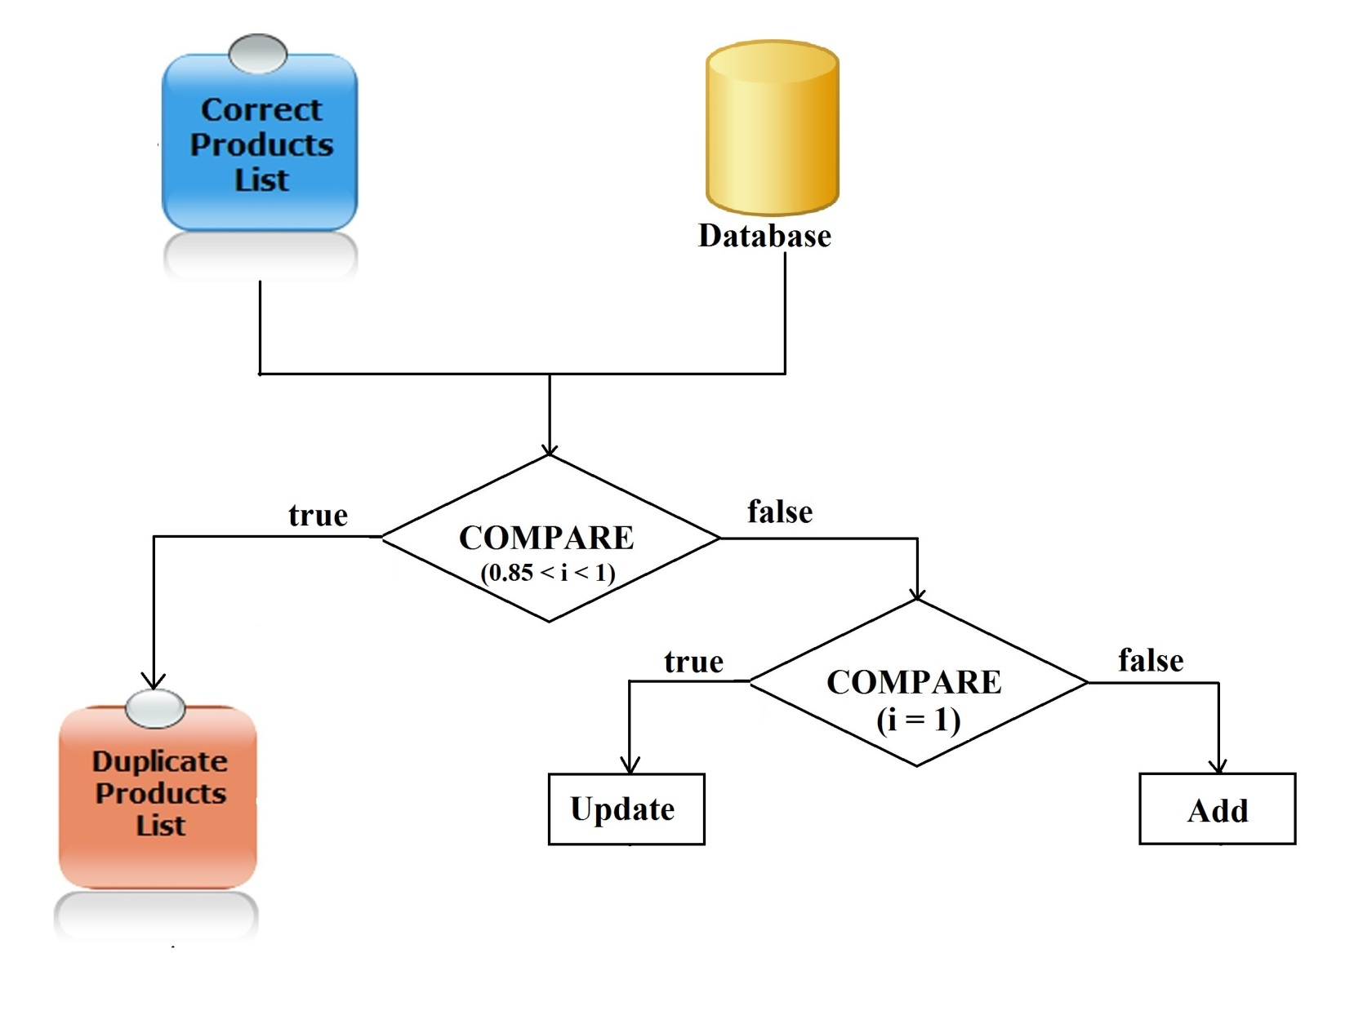
Import Excel Flow

Slide 19
Excel Flow
Step 1: Import Excel.
Step 2: Process error products & duplicate products.
Step 3: Save correct products to database.
Step 4: Process duplicate products with database.

Slide 20
Data mining from websites
Get link
Inspect

Slide 21




Smart Buy System
1.1
1.4
Guest
1.2
1.3
2.3
2.6
2.4
2.2
2.5
2.1
Member

Slide 22



Slide 23
Future Plan

Slide 24
THANK YOU FOR YOUR ATTENTION! Q & A

